Slide 1
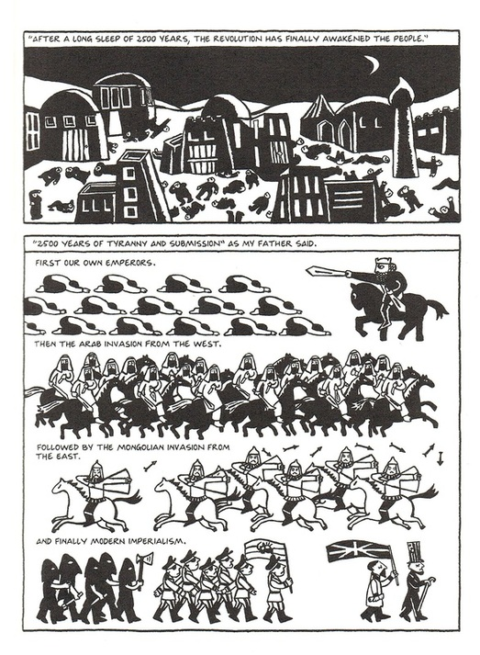
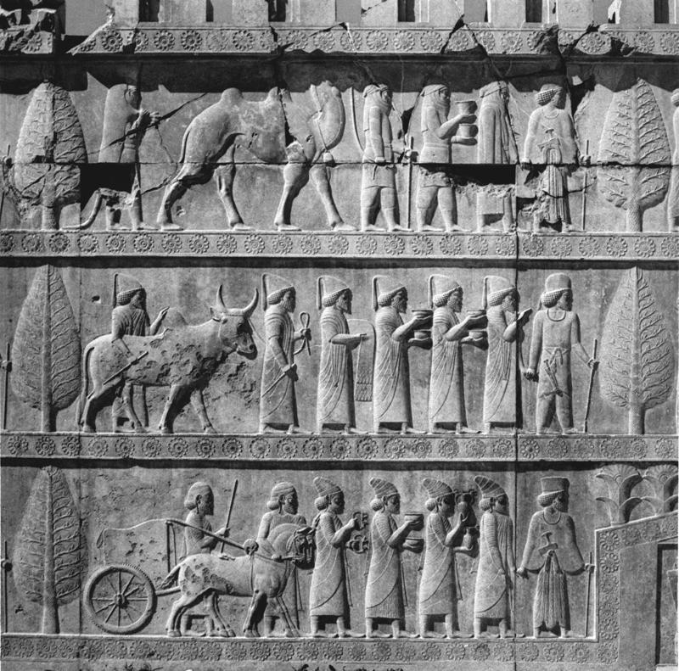
Compare the style of the two. Do they share any similarities?

Slide 2
Quick Write #5
Directions: Write a complete response to the following prompt. A well-done response will be at least one full page.
Prompt: Compare and contrast the historical art from the ancient city of Persepolis. How are they similar? How are they different? What do you think is Satrapi’s goal in using the graphic form to tell her story? How does her personal story relate to the history of her ancient country?
Grading: This is an assessment grade and will be in the Performance category. It will be work 20 points and it will graded on the Quick Write rubric (look in your syllabus for the criteria).

