Slide 1
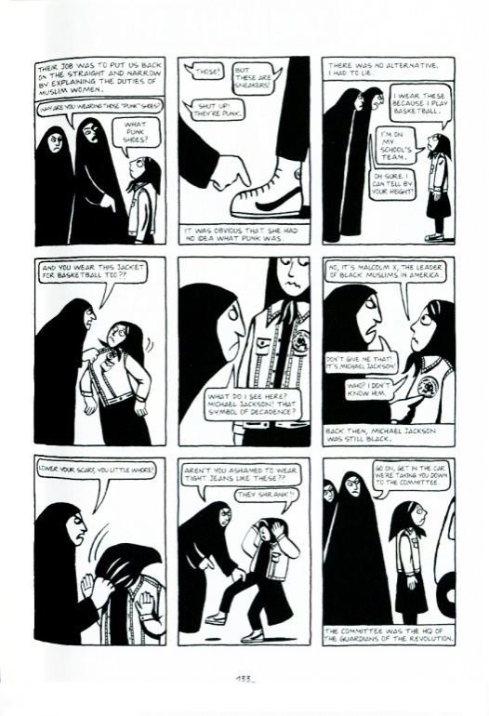
Quickwrite #2
On your paper:
Look at page 133 in the book and answer the following questions:
Imagine a world where doing simple things like wearing Nikes would amount to defiance. How would you choose to express themselves if society prevented you wearing the brands you liked?

