Slide 1
Day 2: Words vs images

Slide 3
What is different about Comics and Traditional literature?
Comics use images in addition to words to create the imaginative world of their stories and move the plot along.

Slide 4
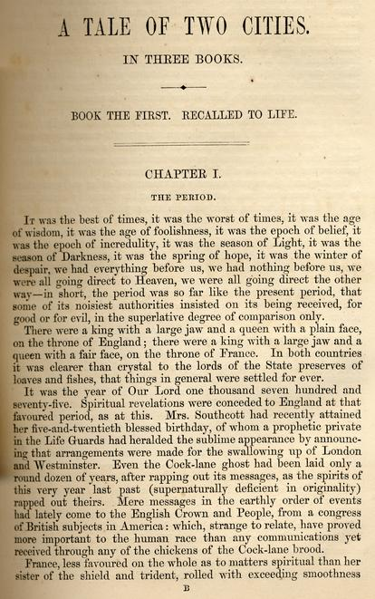
Traditional Literature Vs. Comics
What similarities or differences do you notice between the two?

Slide 5
Images Require Equal Participation
To do so, they must tap into a shared experience that readers and authors both understand.

Slide 6
Example:
What emotions are represented here? How does Bill Watterson communicate them? Are you able to understand it without the words?

Slide 7
The Treachery of Images
In this famous painting by Rene Magritte, the words (trans: This is not a pipe) seem to create a contradiction. But do they really?

Slide 8
Reading Images
Like words, images only represent something.
The reader must interpret what it is and what it means.
This means that images can be read in much the same way as traditional text.

Slide 9
The Vocabulary of Comics
Icon- any image used to represent a person, place, thing or idea.

Slide 10
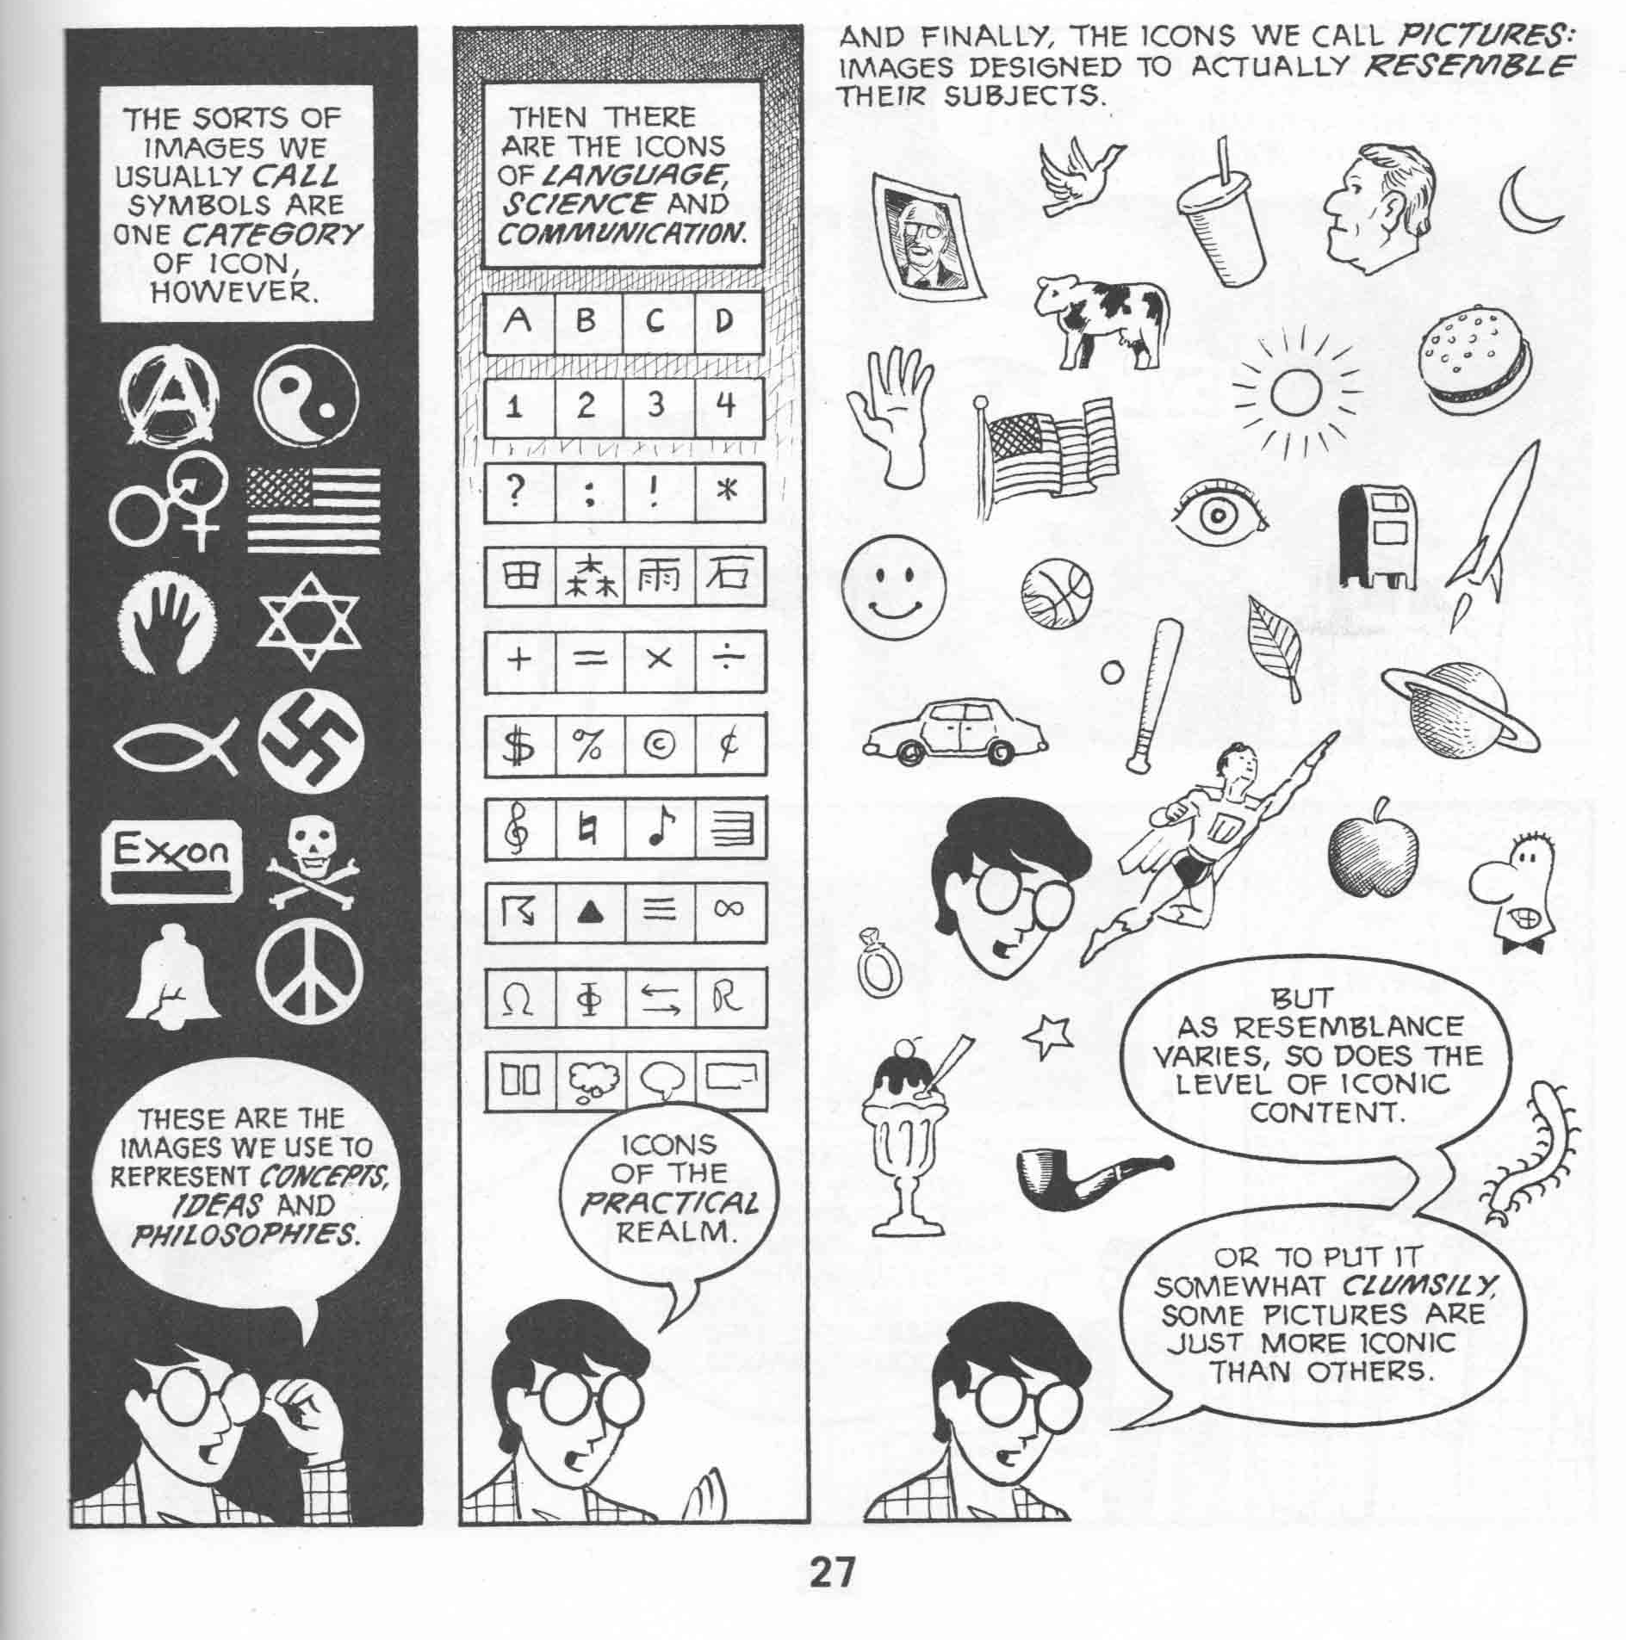

Slide 11
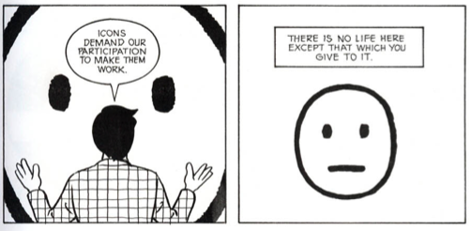

Slide 12
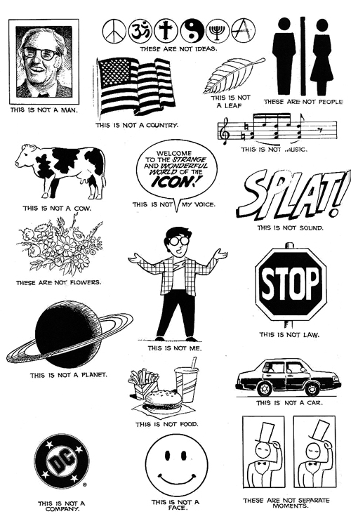

Slide 13
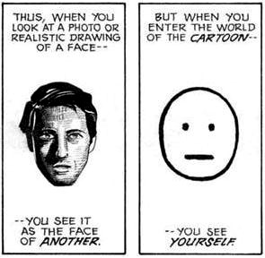
The Vocabulary of Comics
Face: One of the most important uses of icons is for faces.
Simple drawing of a face can communicate a great deal,
especially when you consider how it is drawn.
As readers, we must pay attention to facial expression
because they give us “windows into the mind” of the
characters.

Slide 14
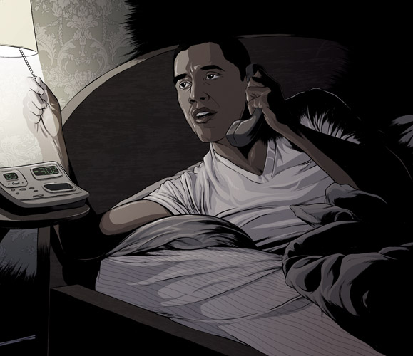
Consider the difference

Slide 15
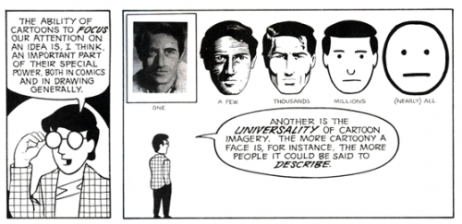

Slide 16
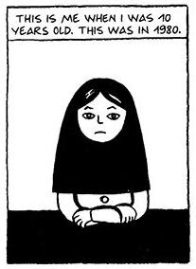
Persepolis begins with
A Face

Slide 17
Quick Think
Why might an author who wants to tell the real story about a place that most American’s think is full of radicals who just want to develop a nuclear bomb choose to begin her story with a close up of a very simply drawn face?

