Slide 1
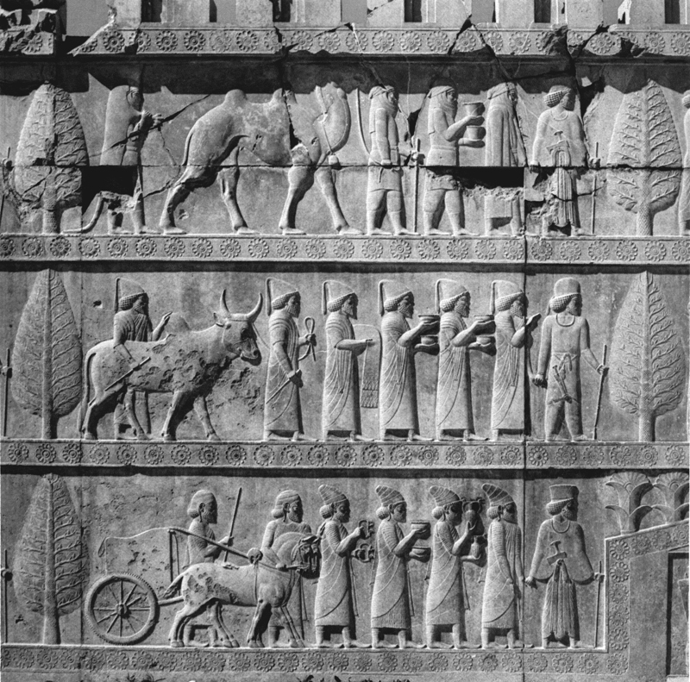

Slide 2
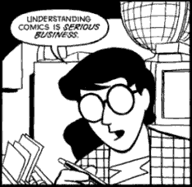
How to Read Comics
They’re not just for kids.

Slide 3
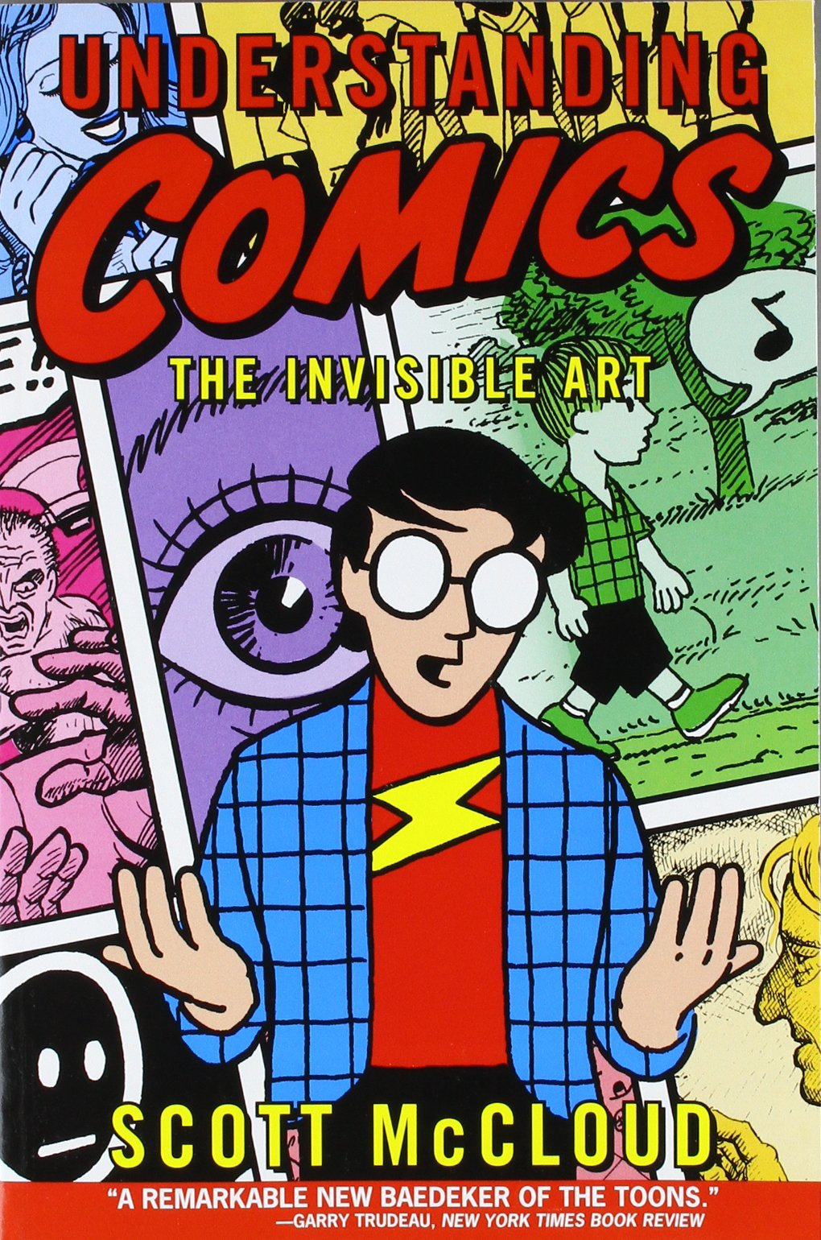
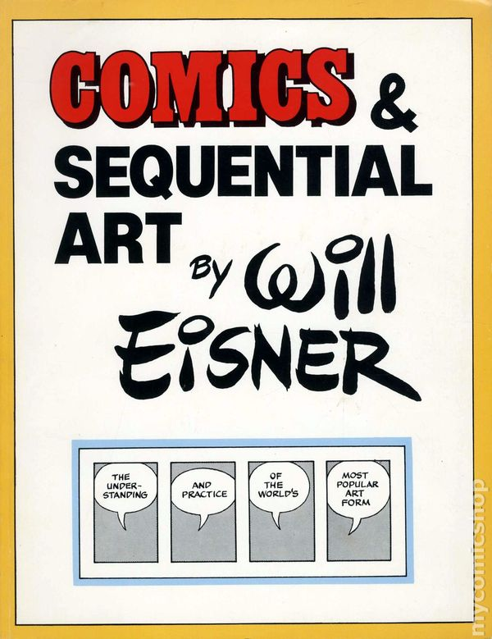
Citation:
Much of the material contained in these slides is derived from Scott McCloud’s Understanding Comics, 1993.
With some additional help from Will Eisner’s Comics and Sequential Art, 1985
All the material used in this slideshow is for educational purposes only.

Slide 4
What are Comics?
Comics are best defined as sequential art.
What this means is that comic art uses pictures that are arranged in space in such a way that they work together to tell a story.

Slide 5
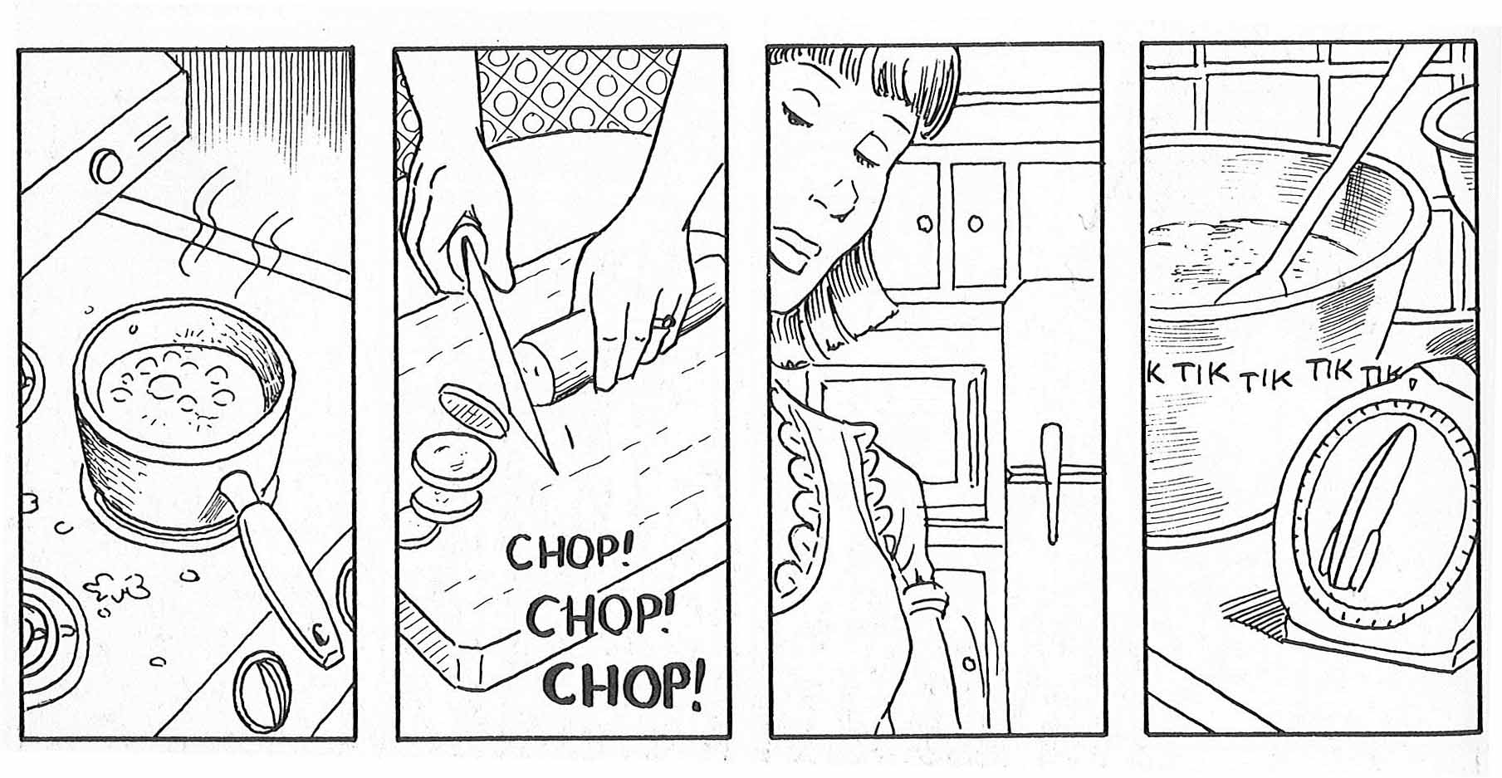

Slide 6
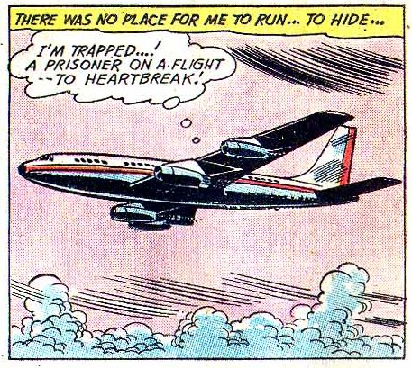
Comics Also consist of
Captions: boxes of text that narrate the action taking place.

Slide 7
Comics consist of
Thought bubbles: curved clouds of texts with a trail of smaller circles that represent what a character is thinking in a particular scene.

Slide 8
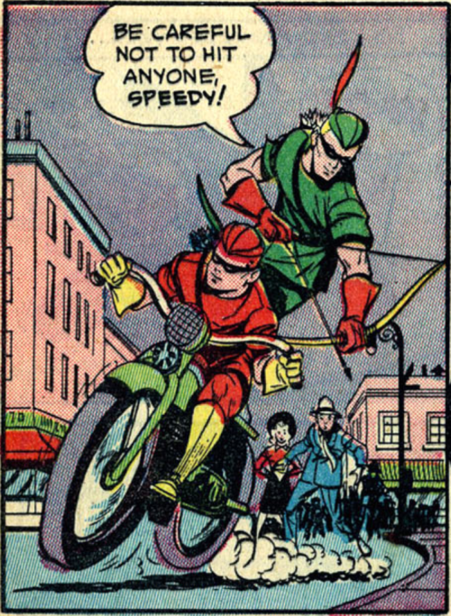
Comics consist of
Speech Bubbles: expressive clouds of text that represent what a character says out loud in a specific scene.

Slide 9
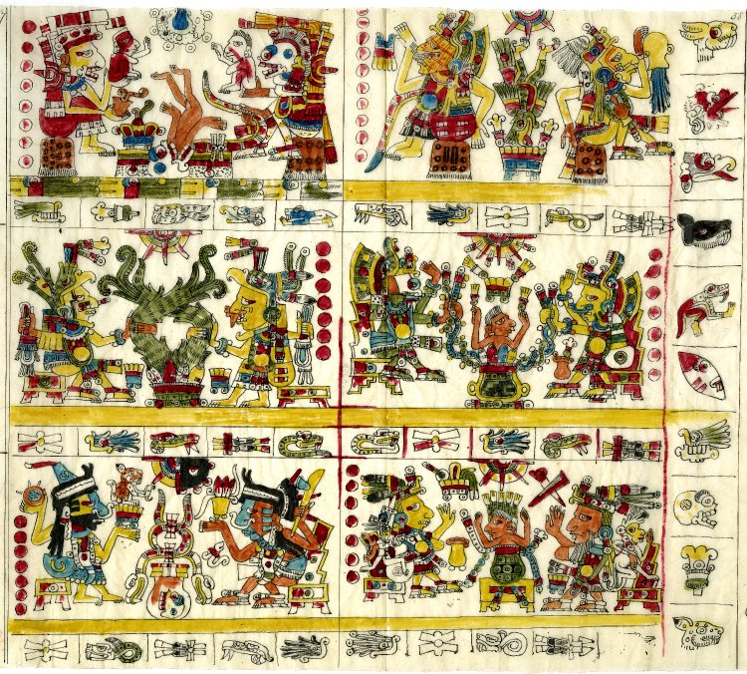
Historical Forerunners
Pre-Columbian Picture manuscripts (discovered by Cortez in 1519)

Slide 10
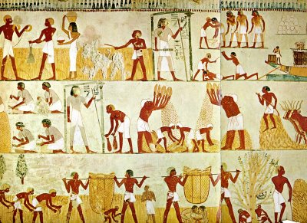
Historical Forerunners
The Tomb of Menna (circa 1300 bce)

Slide 11
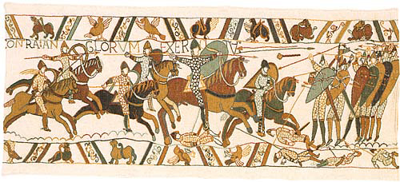
Historical Forerunners
The Bayeux Tapestry, a 230 foot long visual commemoration of the Norman Conquest of England in 1066

Slide 12
Historical Forerunners
The torture of St. Erasmus (circa 1460)

Slide 13
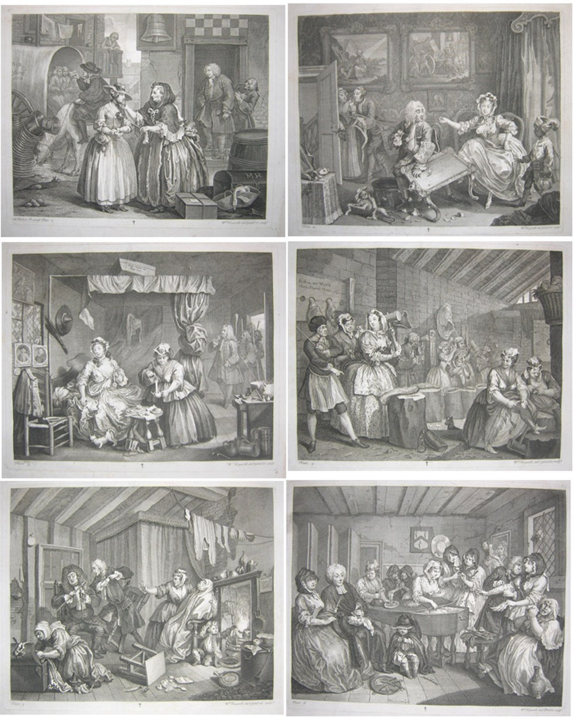
Historical Forerunners
A Harlot’s Progress by William Hogarth, 1731
Fun fact: Reproductions of A Harlot’s Progress and its sequel, A Rakes Progress, were so popular new copyright laws were written to protect this new form of writing!

Slide 14
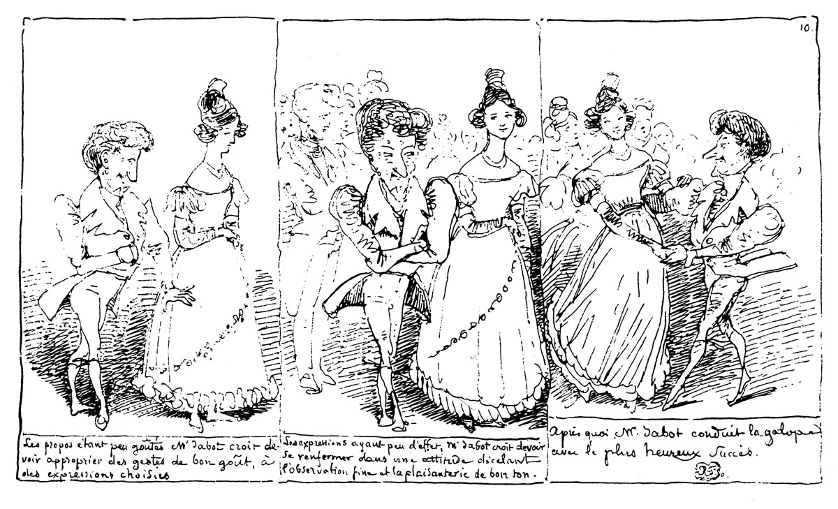
Historical Forerunners
Rodolphe Topffer Mid-1800s
Fun fact: he was the first to use interdependent words and pictures as part of his story telling technique (more on this later).

Slide 15
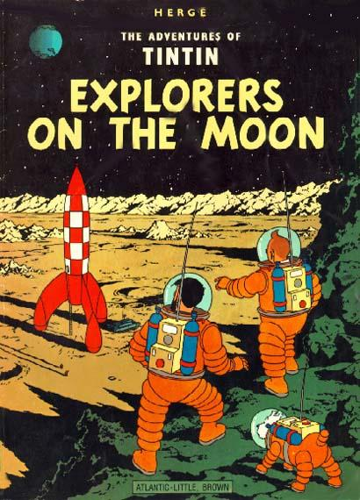
In the last Century
The variety and popularity of comics exploded!

Slide 16
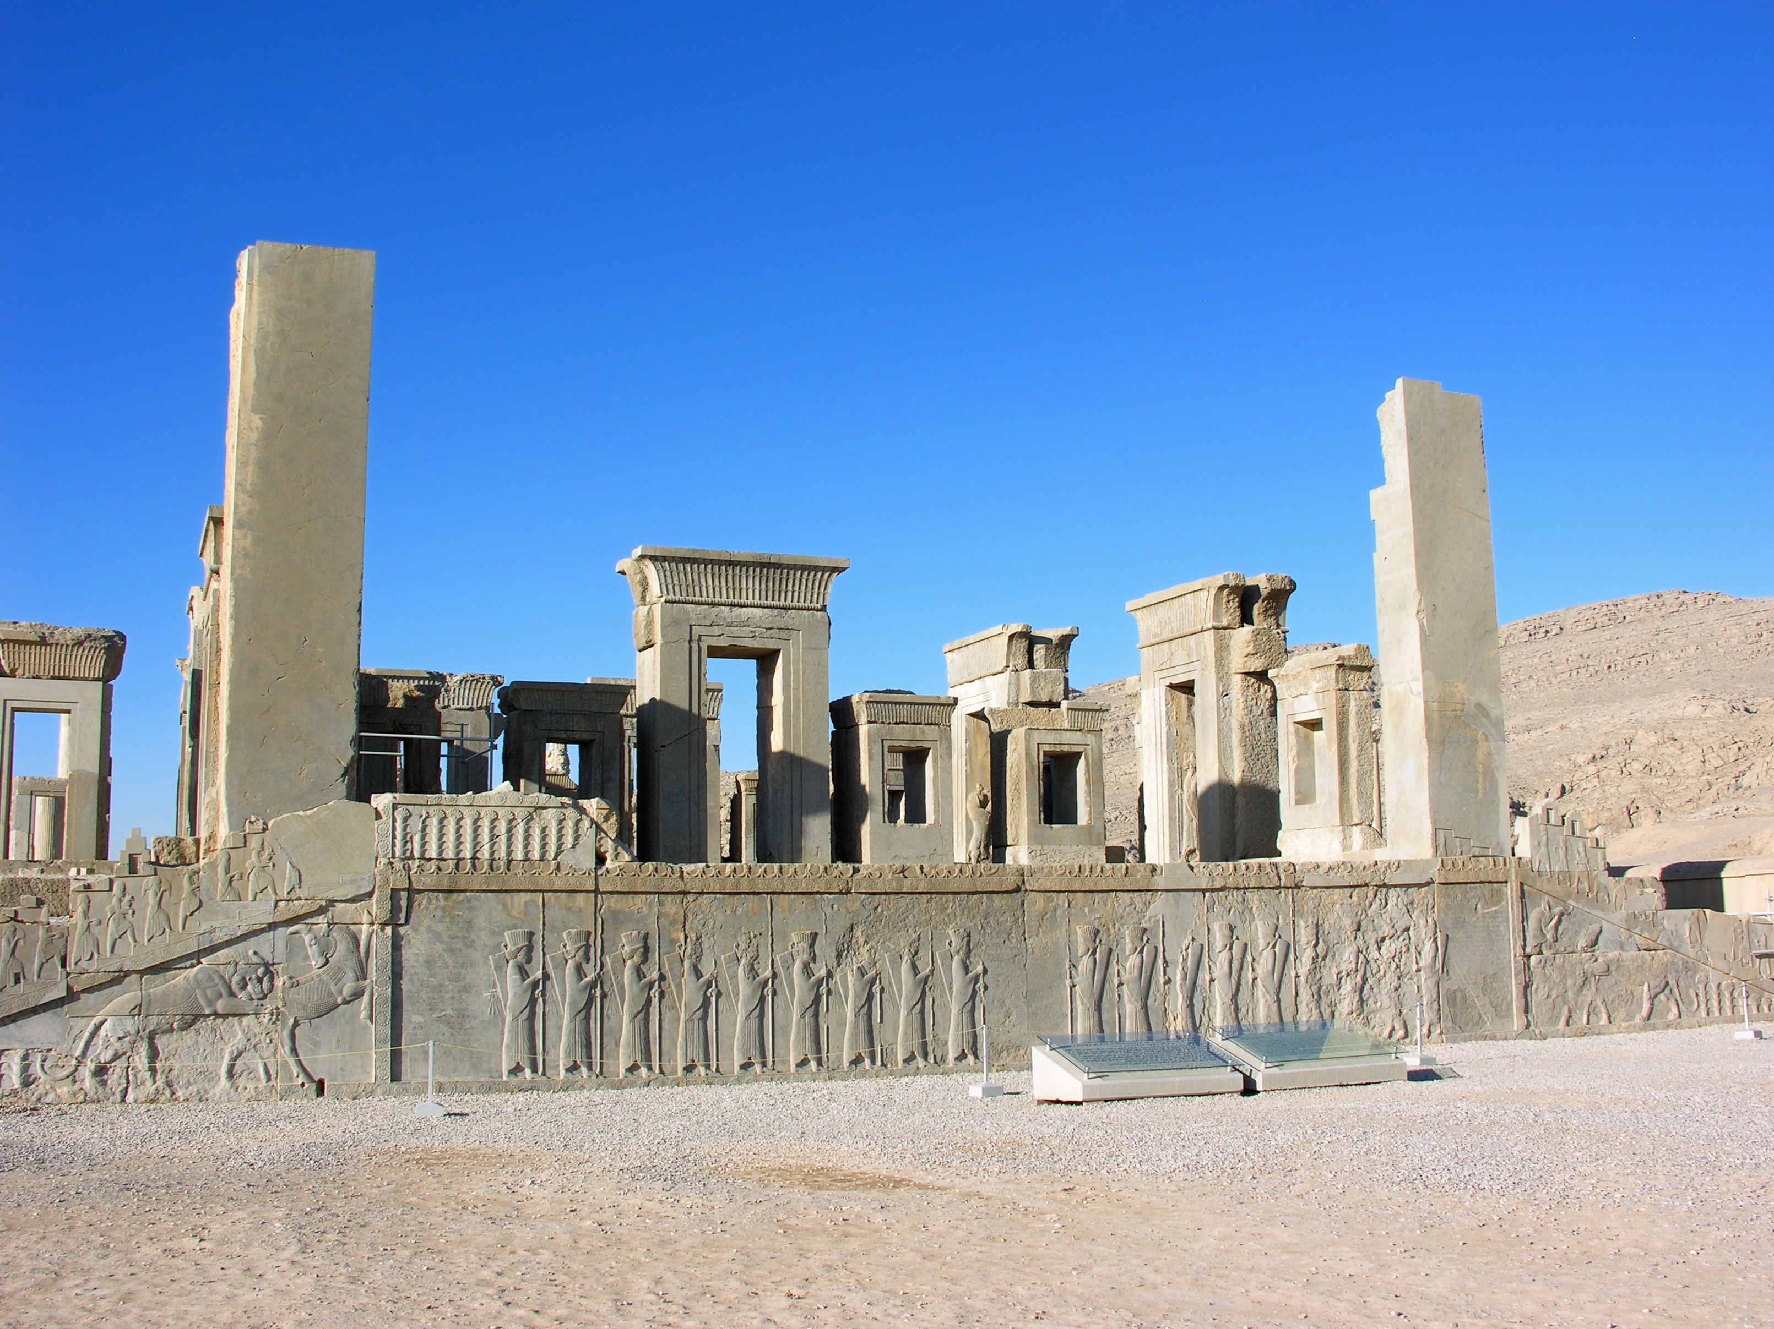
So do the stone reliefs in the ancient Iranian city of Persepolis count as comics? In what ways are they similar? How might they be different?

Slide 17
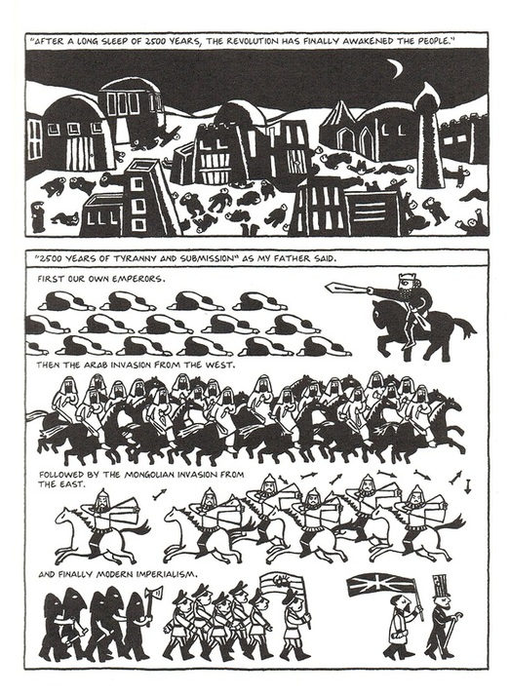
Compare the style of the two. Do they share any similarities?

